Slide 1





Spotify
GROUP 5 PRESENTS:
SPOTIFY’S DAILY SONG RANKINGS
BUSINESS 5100: BUSINESS ANALYTICS
BY: MELODY GULLIVER, GRECIA HERNANDEZ LUGO, JAIR ROCHA, & DIANA ROMAN
Start Slide

Slide 2

Key Data Points: Artist, Track Name, Region, Number of Streams, Date
Objective: Analyze streaming trends to understand listening pattern behavior and influencer (artist, region, date) contributions
Importance:
Trending media influences cultural paradigms, destabilizes barriers, and drives global economies.
These insights can be used to predict future trends and strategizing business decisions
ABSTRACT OVERVIEW

Slide 3
Existing literature has analyzed music consumption as a driver of changes in cultural and business strategy.
Recent literature has shifted focus to new listening models (streaming) and their influence
Research has found usage patterns and music landscape changes, which can be worthwhile for businesses in any industry to recognize
BACKGROUND

Slide 4
Prior studies: Generalized examination of music behavior on cultural trends
(1) Barata, Lopes, and Coelho (2021)
Focus: the effects of streaming platforms on consumption habits.
Takeaway: algorithms shape user preferences
Takeaway: music affects brand attitude and purchase intention
Our study: A geo-spatial, SAP-driven analysis of Spotify’s daily ranking data and its correlation with shifts in mainstream culture.
RELATED WORK

Slide 5
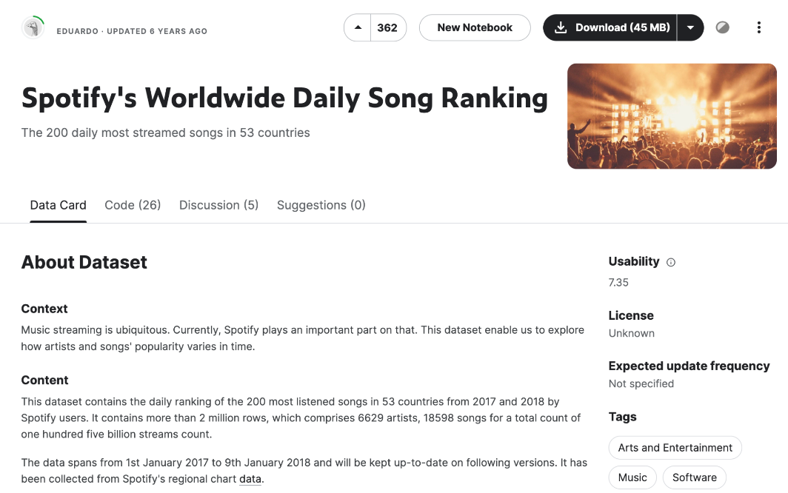
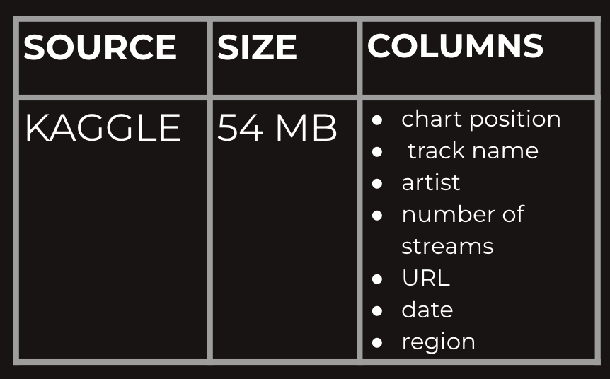
The Data Set: Spotify Worldwide Daily Song Ranking
We leveraged the below dataset to examine the listening habits of 53 countries across several variables.
SPECIFICATIONS
We applied various SAP analysis tools to our data set.

Slide 6
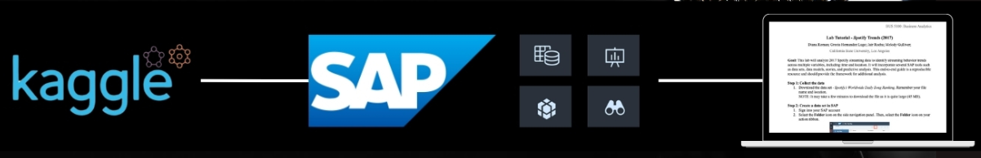
Collected data through Kathleen
Created data set through SAP
Cleaned data set
Built model, story visualizations, and predictive analysis
Created support materials (lab, paper, and presentation)
IMPLEMENTATION PROCESS

Slide 7
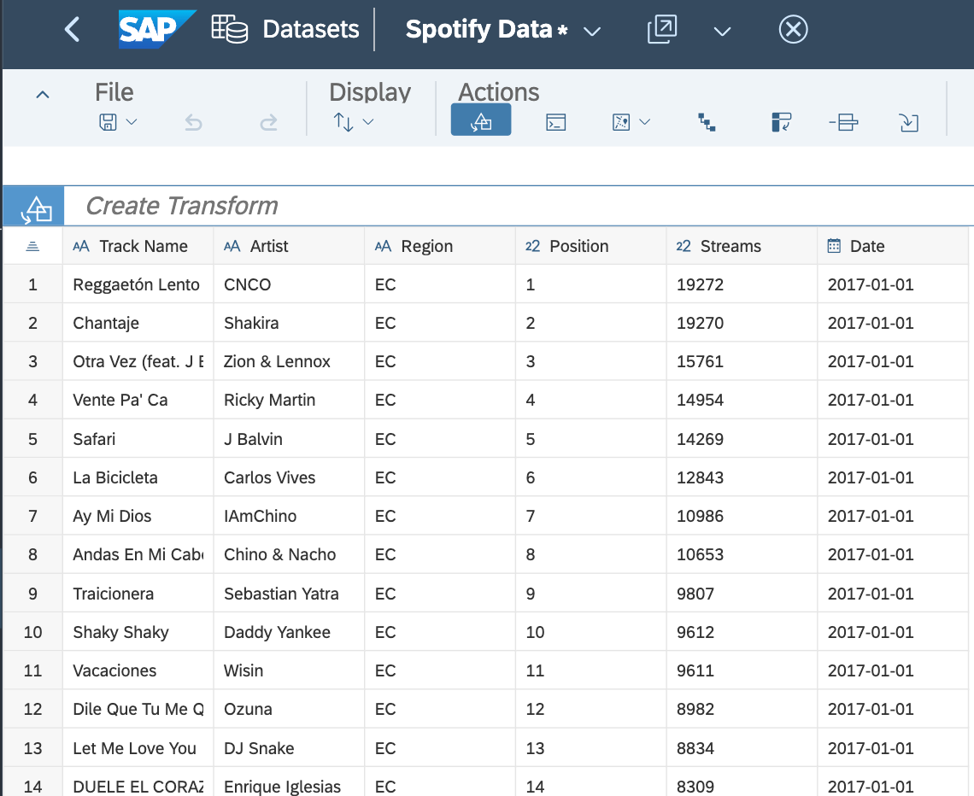
DATA SET

Slide 8
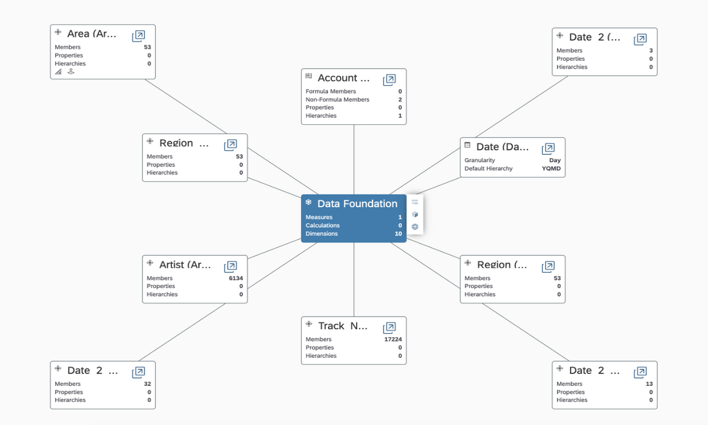
DATA MODEL

Slide 9
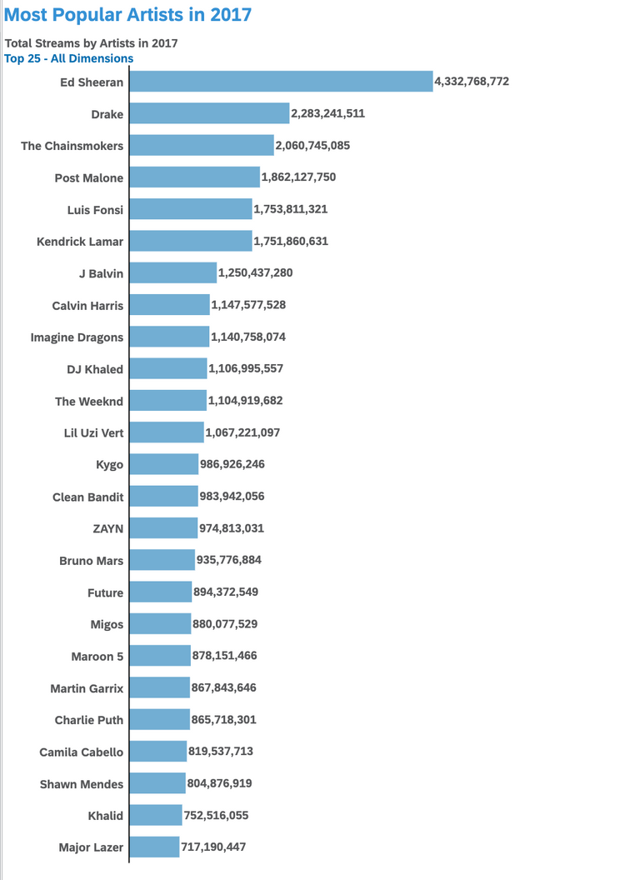
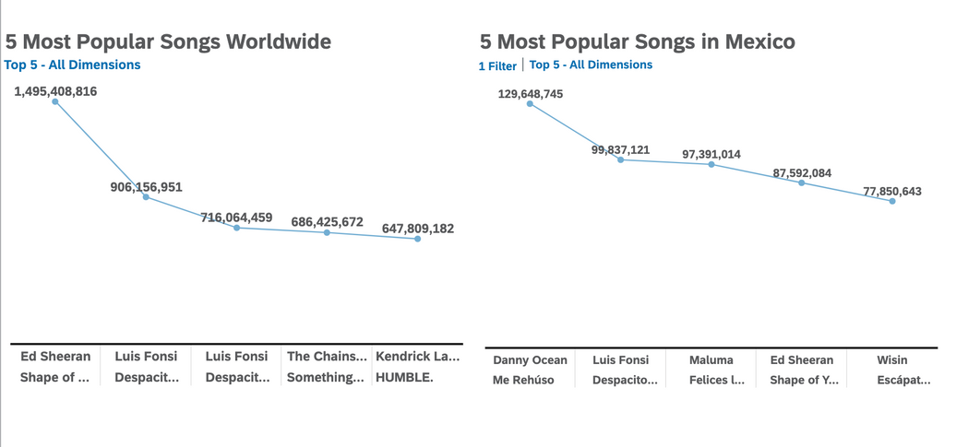
As shown in both charts, Ed Sheeran was the most popular artist in 2017 and had the most streamed song “Shape of You” that same year.
GLOBAL ANALYSIS & VISUALIZATIONS

Slide 10
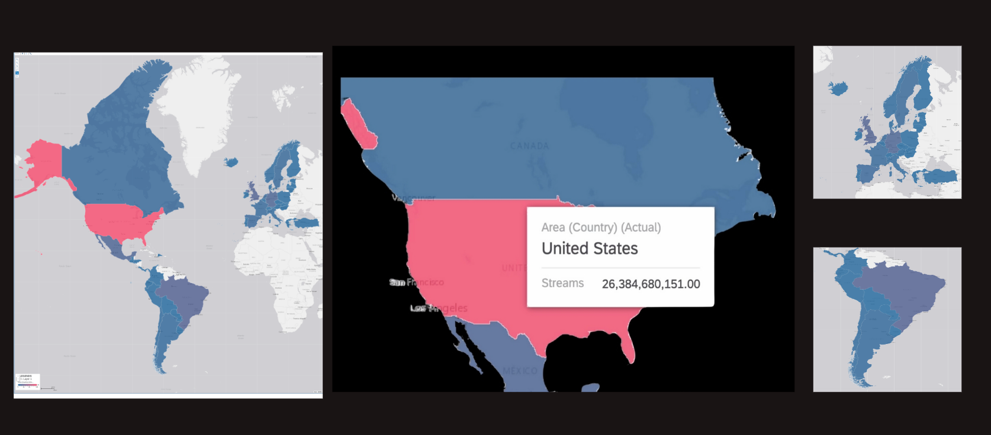
STREAMS BY NATION IN 2017
GLOBAL ANALYSIS & VISUALIZATIONS

Slide 11
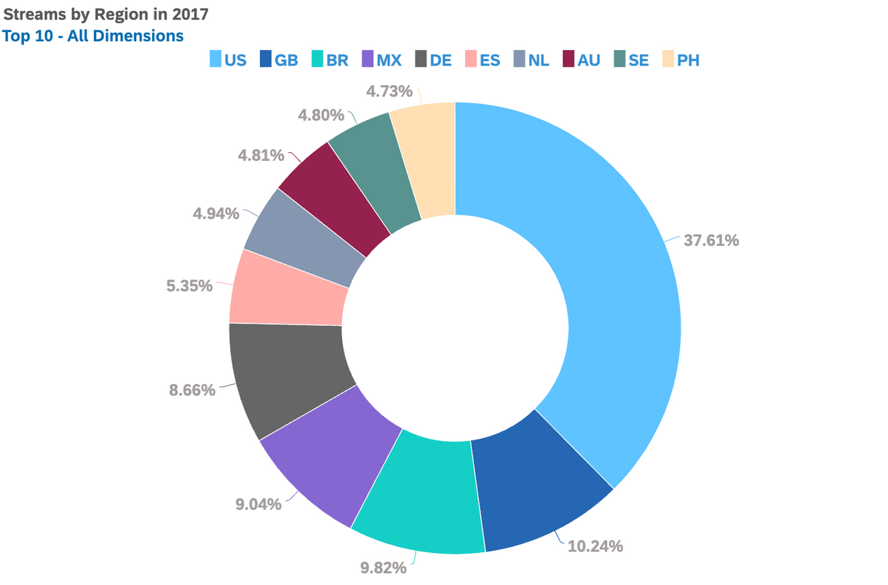
SPOTIFY STREAMS PER REGION - 2017
The chart shows the Top 10 regions streaming music via Spotify, with the U.S. ranking at 37.61% streams in 2017.
ANALYSIS & VISUALIZATIONS

Slide 12
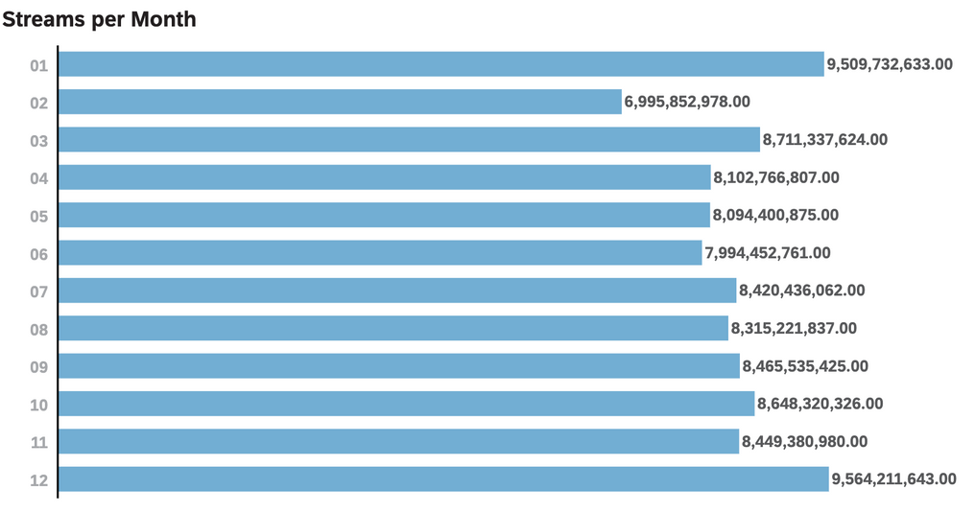
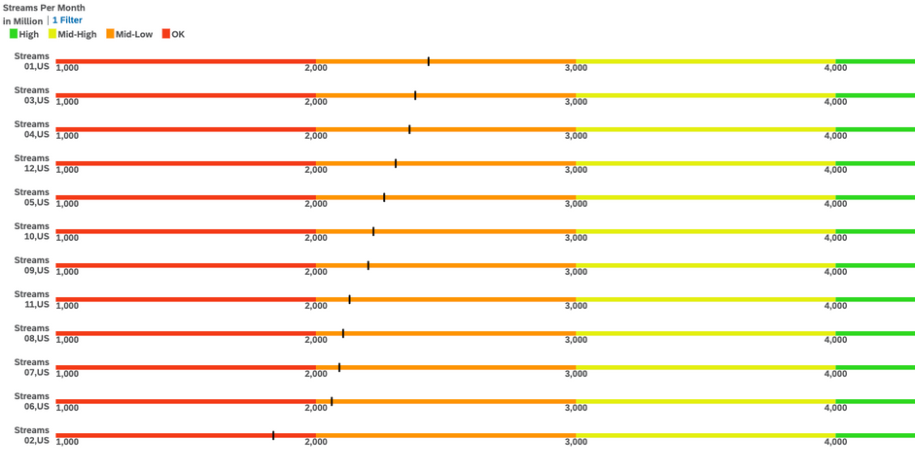
GLOBAL
METRICS COMPARISON:
Global highest streaming months: December
Global lowest streaming month: February (less than 7 billion)
US highest streaming month: January
US lowest streaming month: February
TIME ANALYSIS &
VISUALIZATION
US

Slide 13
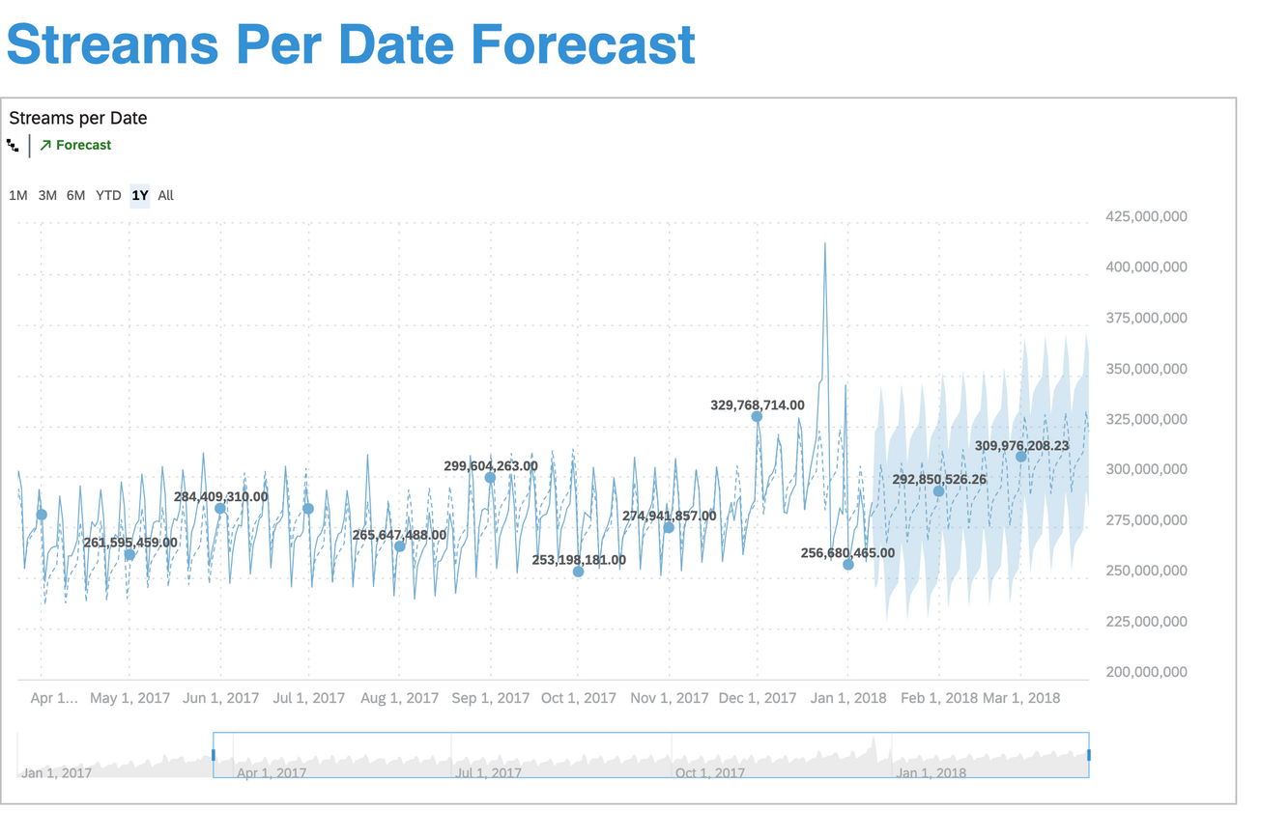
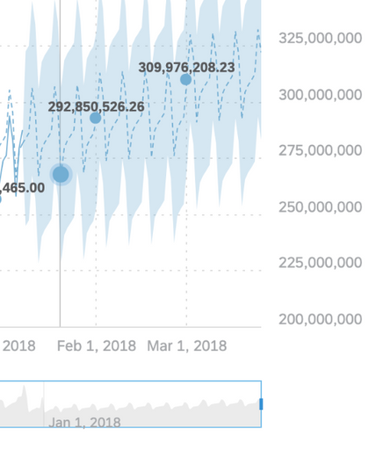
Time series analysis with automatic forecast
End of Jan and Feb display the lowest streaming counts
TIME ANALYSIS &
FORECAST

Slide 14
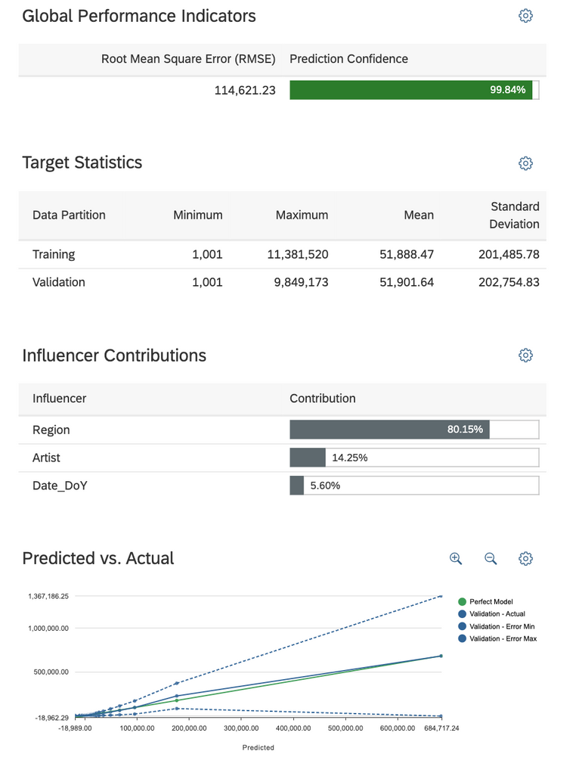
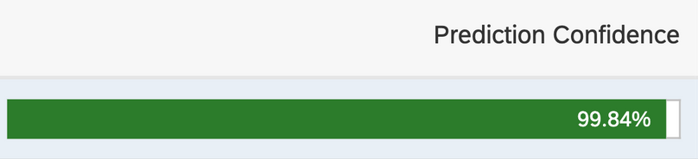
Predictive Analysis: Regression
This analysis helps predict (1) listening behavior based on historical listening patterns
and (2) categorize how influencers impact listening patterns
Prediction Confidence: 99.84%
Influencers: 3
Highest contributing influencer: Region
Could not use classification predictive models because our data set was not binary.
REGRESSION
PREDICTIVE ANALYSIS

Slide 15
Music consumption data analysis provides insights into cultural shifts and consumer behavior.
Spotify's daily chart positions offer a comprehensive view of popular music and its influence.
This study highlights the importance of brands aligning themselves with the most relevant and timely music content
Moreover, the potential for businesses to capitalize on music data to drive product engagement and loyalty
CONCLUSION

Slide 16
https://github.com/BUS5100group5/2017spotifytrends
https://www.kaggle.com/datasets/edumucelli/spotifys-worldwide-daily-song-ranking
Barata, Mariana Lopes, and Pedro Simões Coelho. “Music Streaming Services: Understanding the Drivers of Customer Purchase and Intention to Recommend.” Heliyon, vol. 7, no. 8, Aug. 2021, https://doi.org/10.1016/j.heliyon.2021.e07783.
C, Vickie. “Spotify Is a Pop Culture Icon.” Medium, 2 July 2023, medium.com/@vickiec630/spotify-is-a-pop-culture-icon-ed25e6497c8e.
Eduardo. “Spotify’s Worldwide Daily Song Ranking.” Www.kaggle.com, Kaggle, 2019, www.kaggle.com/datasets/edumucelli/spotifys-worldwide-daily-song-ranking. Accessed 2 Mar. 2024.
Janak, Heather. “How Background Music in Ads Affects Consumers.” Texas A&M Today, 16 Aug. 2021, today.tamu.edu/2021/08/16/how-background-music-in-ads-affects-consumers/.
GITHUB

